Slide 1
Ingredients for a European Fiscal Revolution
Thomas Piketty
Paris School of Economics
Brussels, PES Meeting, November 25th 2011

Slide 2
Roadmap of the talk
1. Euro-bonds : the current euro zone crisis is very serious; if we do not mutualize our public debt, there is a serious risk that the euro becomes very unpopular very soon
→ new treaty & new euro-parliament
2. Euro-taxation:
2.1. General context: globalization, inequality ↑, low growth → we need tax justice & fiscal progressivity more than ever
2.2. Personal income tax: left to member states? Ok but we need EU help, e.g. automated information exchange; so far savings directive didn’t work → no more unilateral deals
2.3. Corporate income tax: FTT not enough; we need EU corporate tax → no more unilateral corporate tax cuts
2.4. New balance between labor and capital
→ no more unilateral repeal of wealth taxes
→ without binding commitments (in PES platform?), local socialist parties tend to follow tax competition forces & behave like conservatives when they come to power…

Slide 3
1. Getting out the crisis: eurobonds
Euro zone countries have less public debt than US, UK, Japan... but we have a sovereign debt crisis, not them
Europe is the richest economic area of the world: we should be able to fix our public finance pb without asking help to China or Brazil or the IMF...
EU27: GDP 12 tril. €, pop 500m (24 000€ per capita)
(Euro zone: GDP 9 trillions €, pop 330m)
China GDP 4 tril. €, Brazil GDP 1,5 tril. €
EU households own over 50 tril. € in net wealth (incl. over 25 tril. € in financial assets), i.e. 20 times more than China’s reserves (2.5 tril.€), 5 times more than total EU public debt (10 tril. €)
→ our problem entirely come from inadequate fiscal & budgetary institutions

Slide 4
US, UK, Japan pay 2% on their public debt; but Southern European countries – and maybe France in the coming months – pay 5%, 6% or more, including countries with less debt than US, UK, Japan
Why? Because in US-UK-Japan the central bank plays its role of lender of last resort; a large fraction of the extra debt (≈10-20% of GDP) was purchased by the central bank; the ECB holds only 1,5% of GDP in public debt
But the ECB will be able to fully play its role only if euro zone countries mutualize their public debt, which requires federal budgetary decisions, which requires a federal parliament with real budgetary power: either the European Parliament, or a new « European Senate » with MPs from national parliaments’ finance commissions

Slide 5
2.1. Euro-taxation: the general context
Huge rise of income inequality since the 1970s-1980s, especially in the US (>50% of total growth absorbed by top 1%) & in Anglo-saxon countries
We observe the same trend in Continental Europe since the 1990s-2000s
Tax competition tends to reduce taxes on top incomes & capital, and to exacerbate the trend
Tax progressivity also affects on pre-tax incomes
→ so far the rise of inequality has been much less strong in the EU than in the US; but the same process is at work; this can destroy our social model; we should react before it becomes as large as in the US

Slide 6
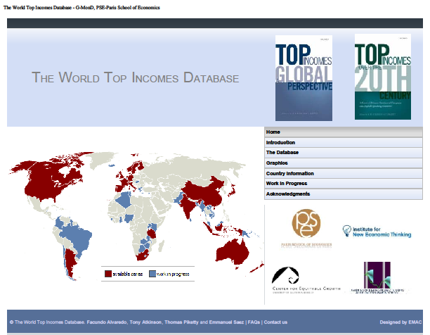

Slide 7
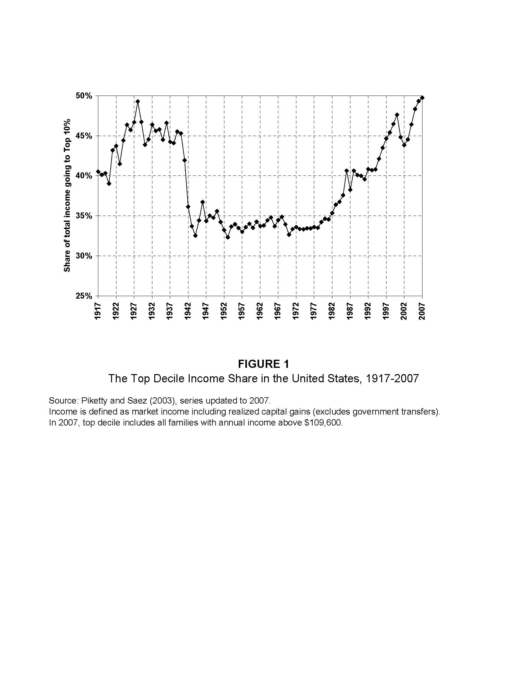

Slide 8
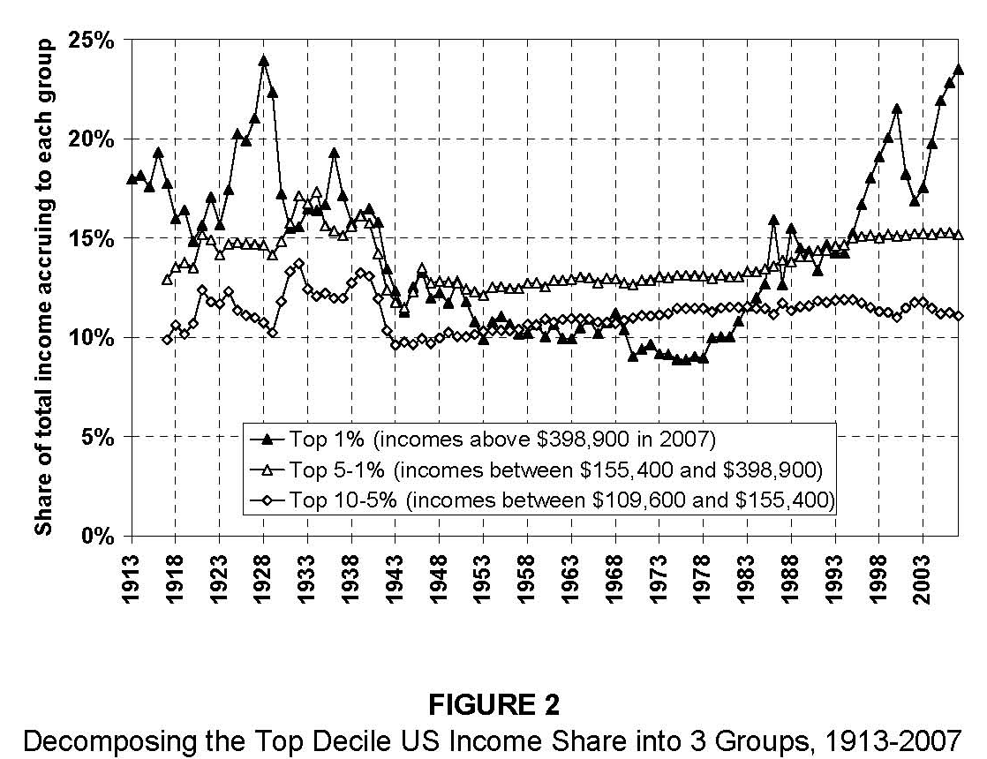

Slide 9
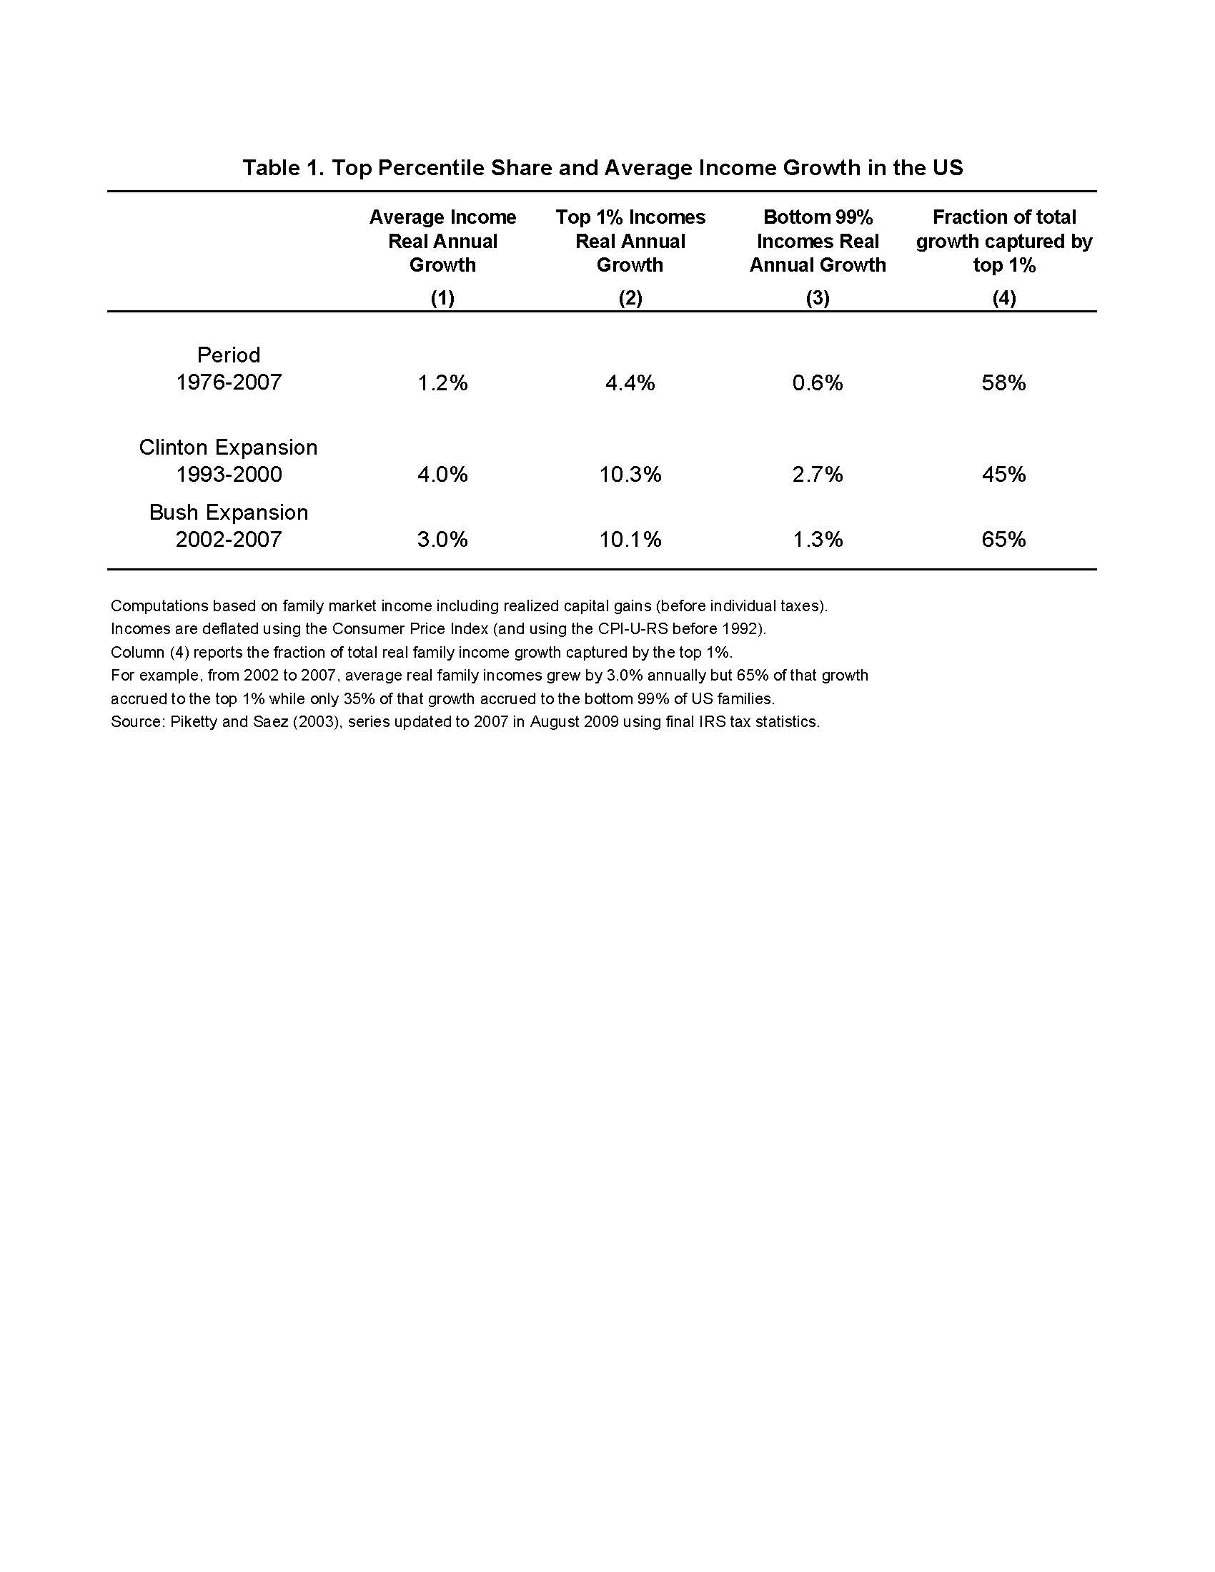

Slide 10
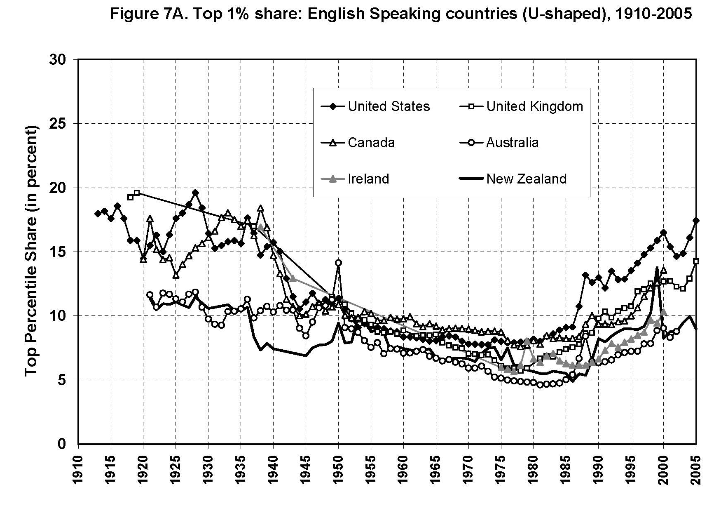

Slide 11
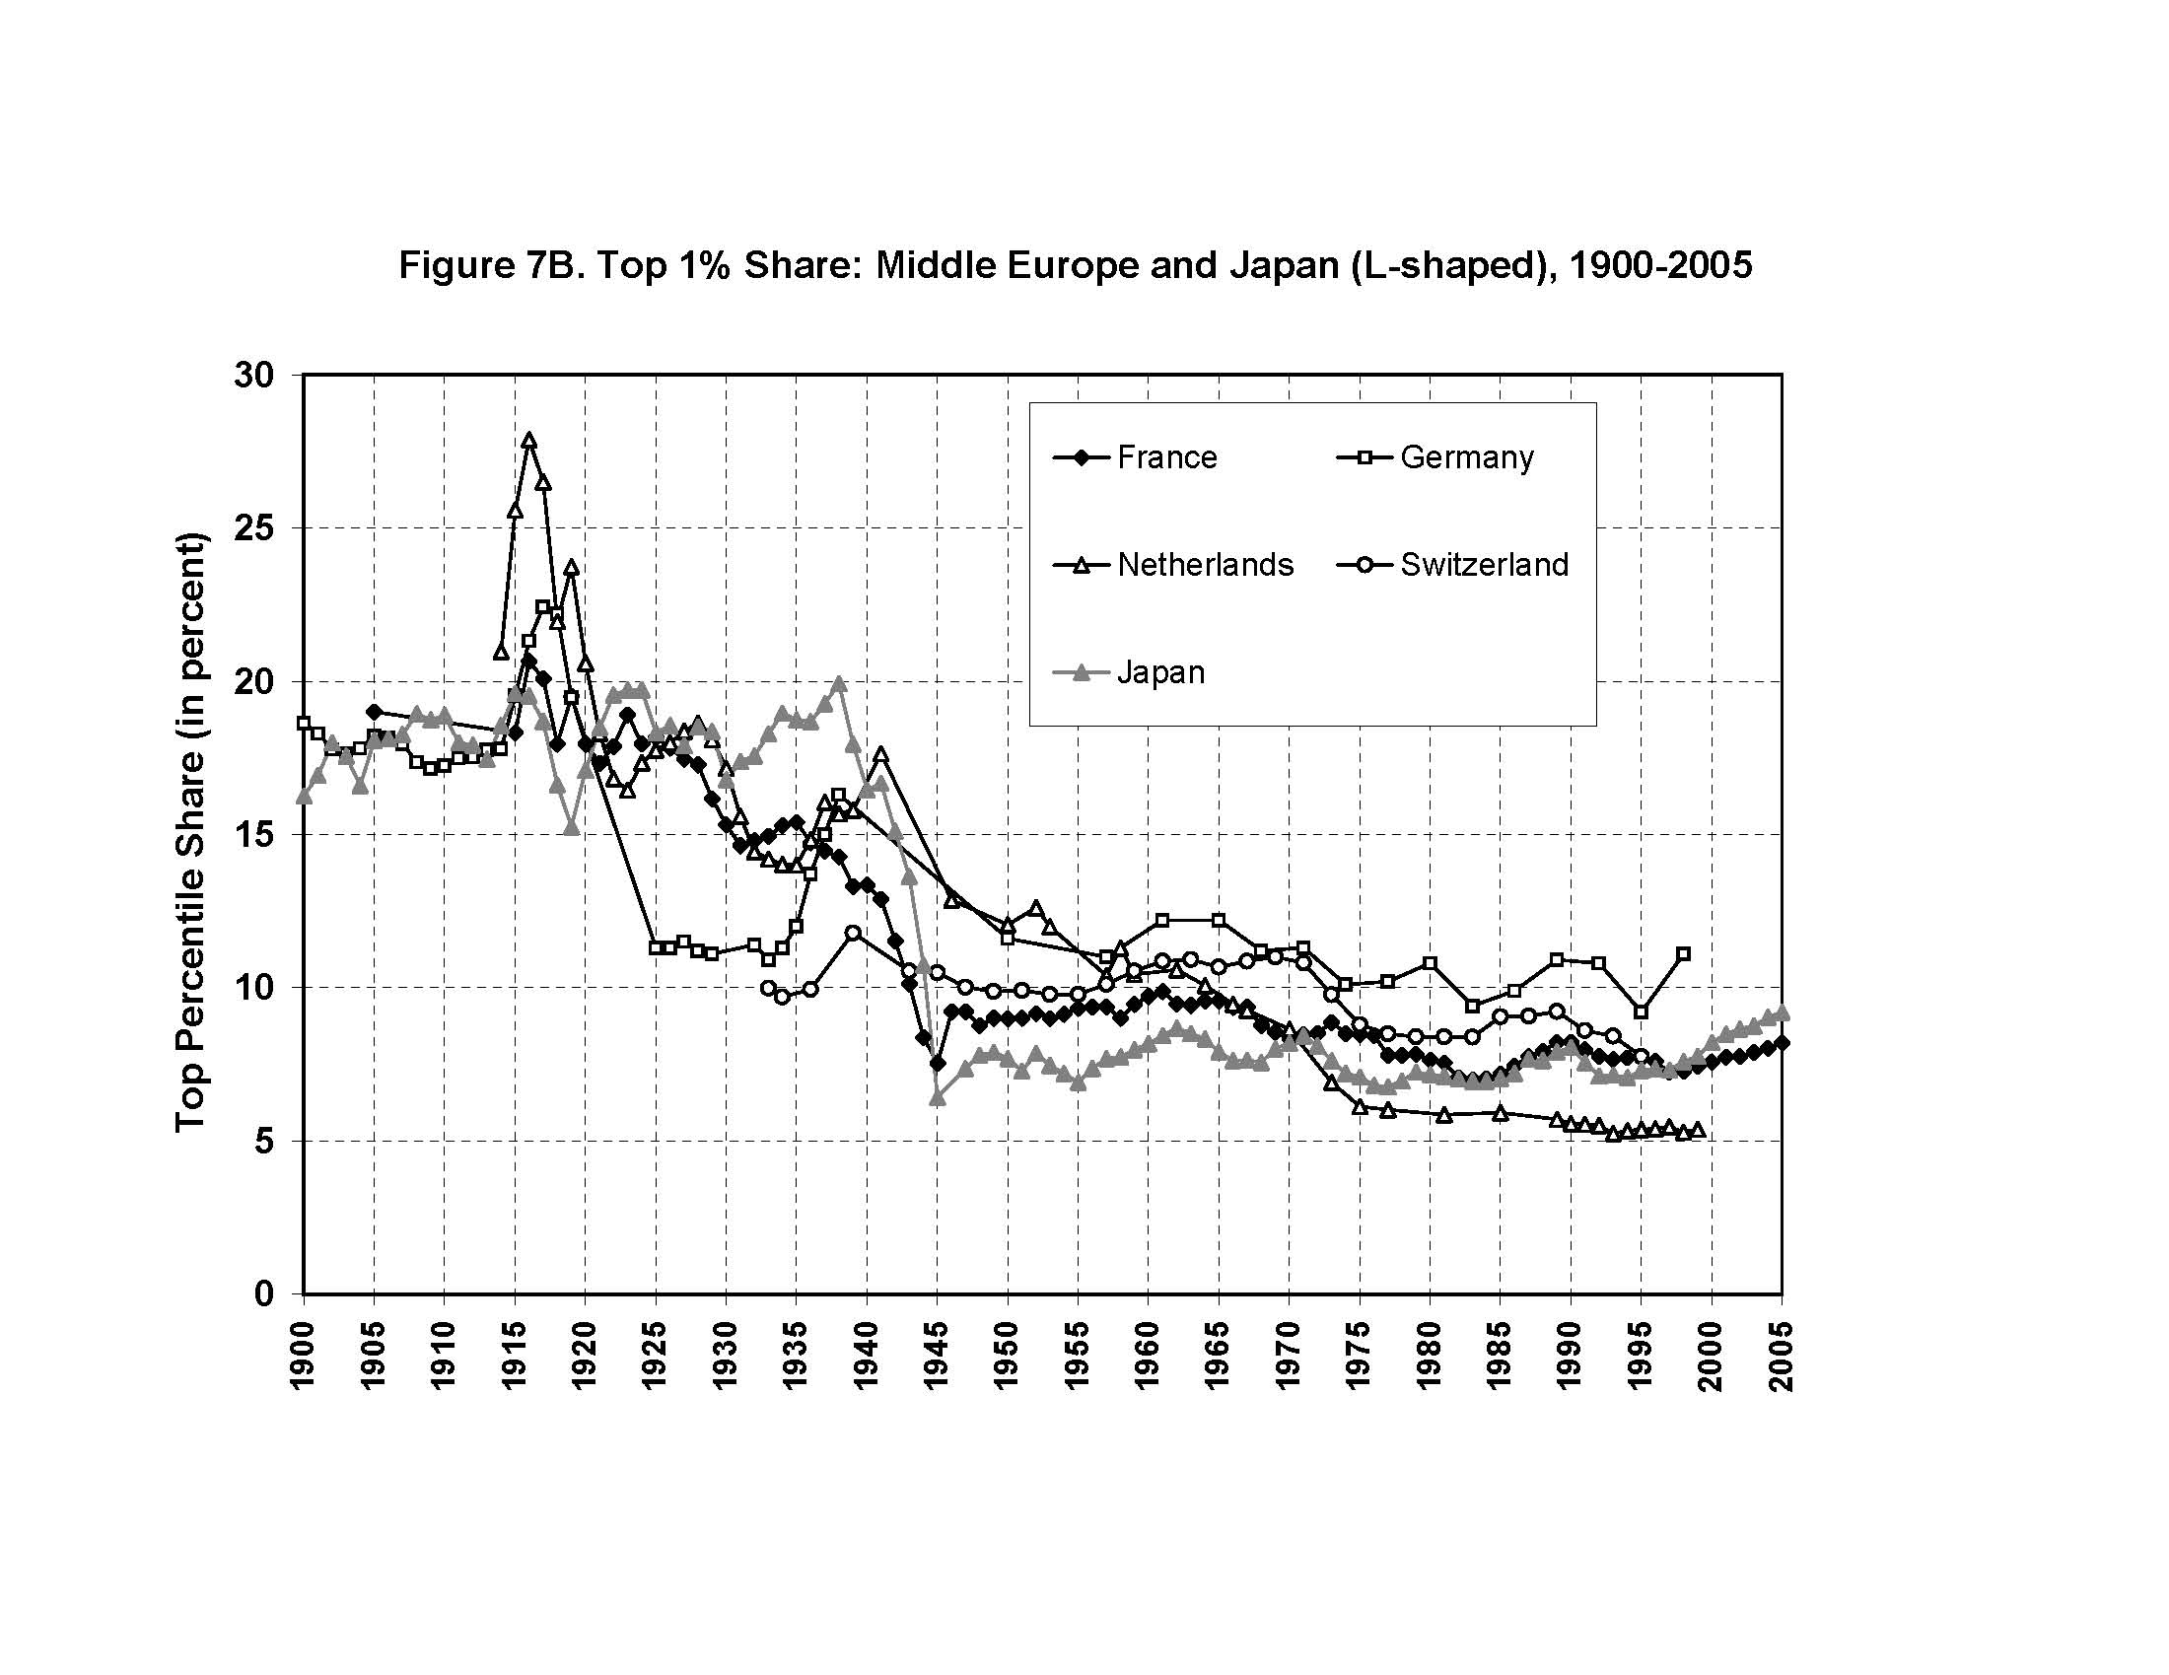

Slide 12
Why are US top incomes so high?
Hard to account for observed variations with a pure technological, marginal-product story
One popular view: US today = working rich have become very productive; they simply get their marginal product (globalization, superstars);
Europe today (& US 1970s) = market prices for high skills are distorted downwards (social norms, etc.)
→ very naïve view of the top end labor market…
& very ideological: we have zero evidence on the marginal product of top executives; it could well be that prices are distorted upwards… very likely given that they set their own price !

Slide 13
A more realistic view: grabbing hand model = marginal products are unobservable; top executives have an obvious incentive to convince shareholders & subordinates that they are worth a lot; no market convergence because constantly changing corporate & job structure (& costs of experimentation)
→ when pay setters set their own pay, there’s no limit to rent extraction... unless confiscatory tax rates at the very top
→ the decline in tax progressivity largely explains the huge rise in top incomes
(memo: US top tax rate (1m$+) 1932-1980 = 82%)

Slide 14
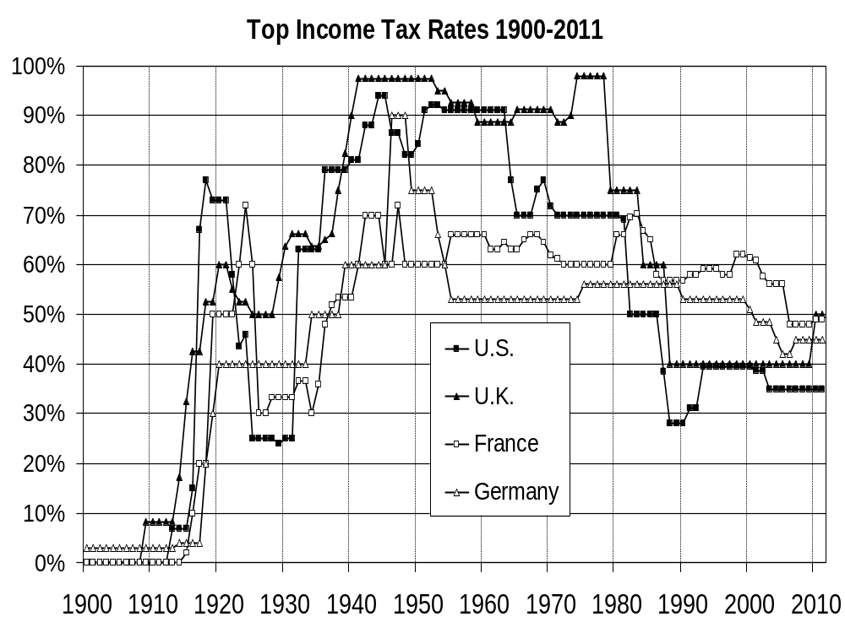

Slide 15
2.2. Personal income taxation
We need tax progressivity more than ever
Standard EU view: personal income taxation should be left to member states. Yes, but…
Yes. We cannot centralize everything at EU level. It makes more sense to centralize corporate taxation rather than personal taxation: firms more mobile than individuals.
There is a lot that member states can do on their own in order to make their tax system more transparent, efficient and progressive
Europe should not be used as an excuse to do nothing
E.g. French income tax particularly archaïc: many special tax regimes, tax not levied at source → tax reform proposal to be implemented at the national level, interactive web site, see www.revolution-fiscale.fr
But… the lack of tax coordination is becoming more and more problematic

Slide 16
(a) Tax competition → gradual decline of top tax rate (+ special regimes to attract foreigners with top incomes, see e.g. Denmark…) → can PES members agree to a minimal top rate of 50% ?
(b) Without automated information transmission between countries, taxing capital income at the same rate as labor income is becoming increasingly difficult
So far the EU savings directive has been a failure: too many loopholes; the “transitory regime” should come to an end; the directive should apply to accounts held via tax havens
Can PES members commit not to pass unilateral side deals with Switzerland and other tax havens ?

Slide 17
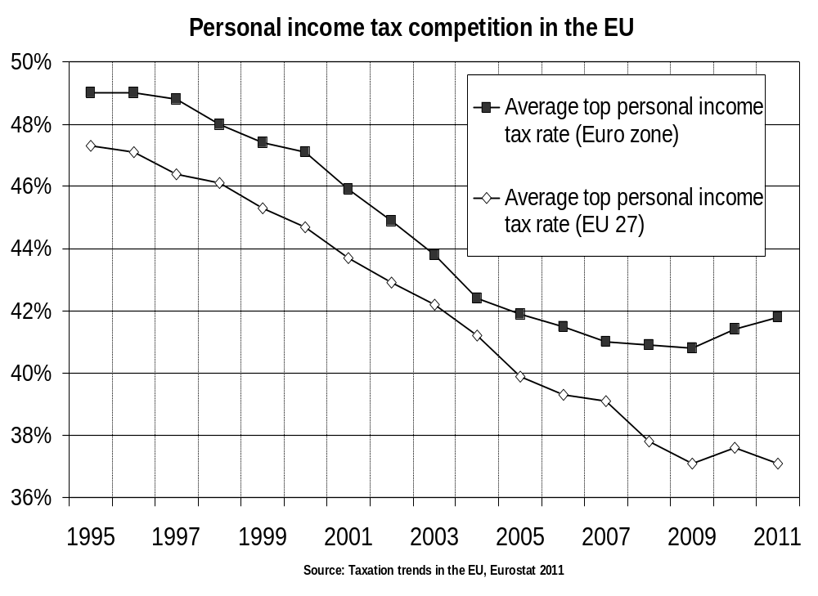

Slide 18
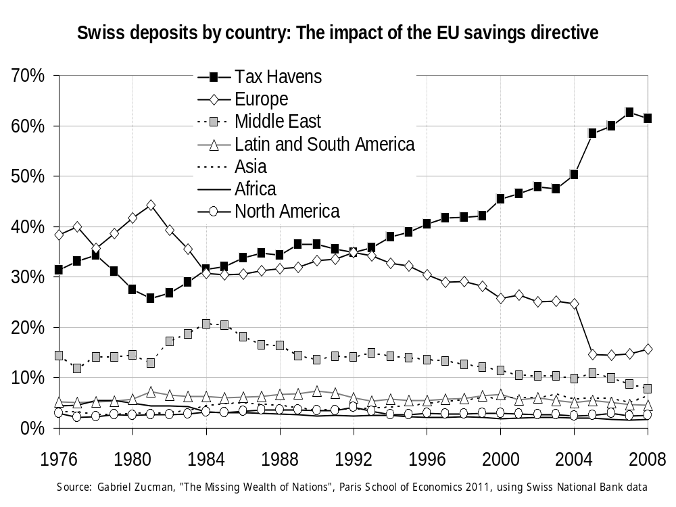

Slide 19
2.3. FTT & corporate income tax
Total financial transactions = 60 x GDP (6000% of GDP)
→ with a 0.05% tax, one can raise 3% of GDP in revenue
… except that the volume of financial transactions will fall following the introduction of a FTT
→ PES flyer: 200bil. € in revenue, i.e.≈ 2% EU GDP
This is probably over-optimistic
FTT revenue: 0.5-1% GDP seems more realistic
[Note: Financial sector ≈ 5-6% GDP, incl. 2% GDP in profits
→ it is hard to raise 2% GDP from a sector making 2% GDP
in profits → be careful with double-dividend illusion]
Bottom line: FTT is a good idea, but is not sufficient
→ we also need a EU corporate income tax

Slide 20
Total corporate profits (fin+non-fin) ≈ 12-13% of EU GDP
→ with a 30% tax, one can raise 3-4% of GDP revenue
→ corporate income tax might be less sexy than FTT, but its revenue potential is much larger !
Pb = tax competition between EU countries tends to drive effective corporate tax rates towards 0%...
In principle, socialist parties are against tax competition
But when they are in power they tend to do the same as conservative parties: see French PS proposal to cut corporate tax rate on re-invested profits in 2012
→ without a EU corporate tax, there will be no more taxation of coportate profits in 10 years…
→ binding commitment in PES platform?

Slide 21
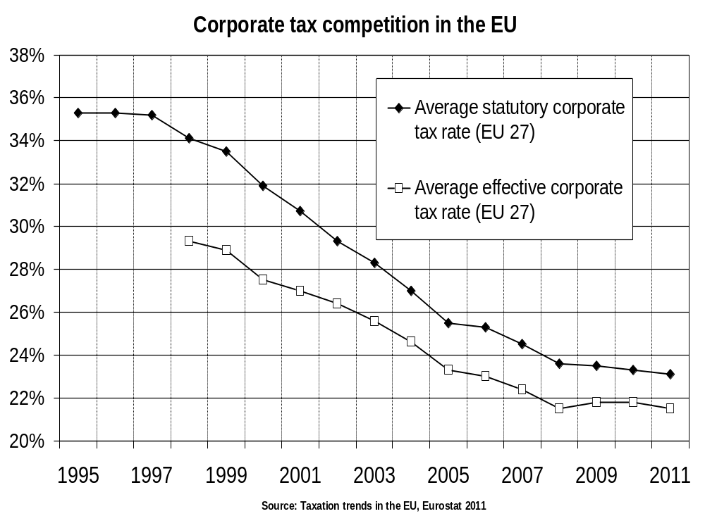

Slide 22
2.4. New balance between labor and capital
Key mechanism: r > g → bad for labor, good for capital → we need a new fiscal balance
With low growth and r > g, two things happen:
wealth-income ratios tend to be very large
inheritance tends to dominate new wealth; i.e. the past eats up the future
(with: r = rate of return to capital = (net profits + rents)/(net wealth); g = growth rate)
Intuition: with r>g & g low (say r=4%-5% vs g=1%-2%), wealth coming from the past is being capitalized faster than growth; heirs just need to save a fraction g/r of the return to inherited wealth
→ It is only in countries & time periods with g exceptionally high that self-made wealth dominates inherited wealth (Europe in 1950s-70s or China today)

Slide 23
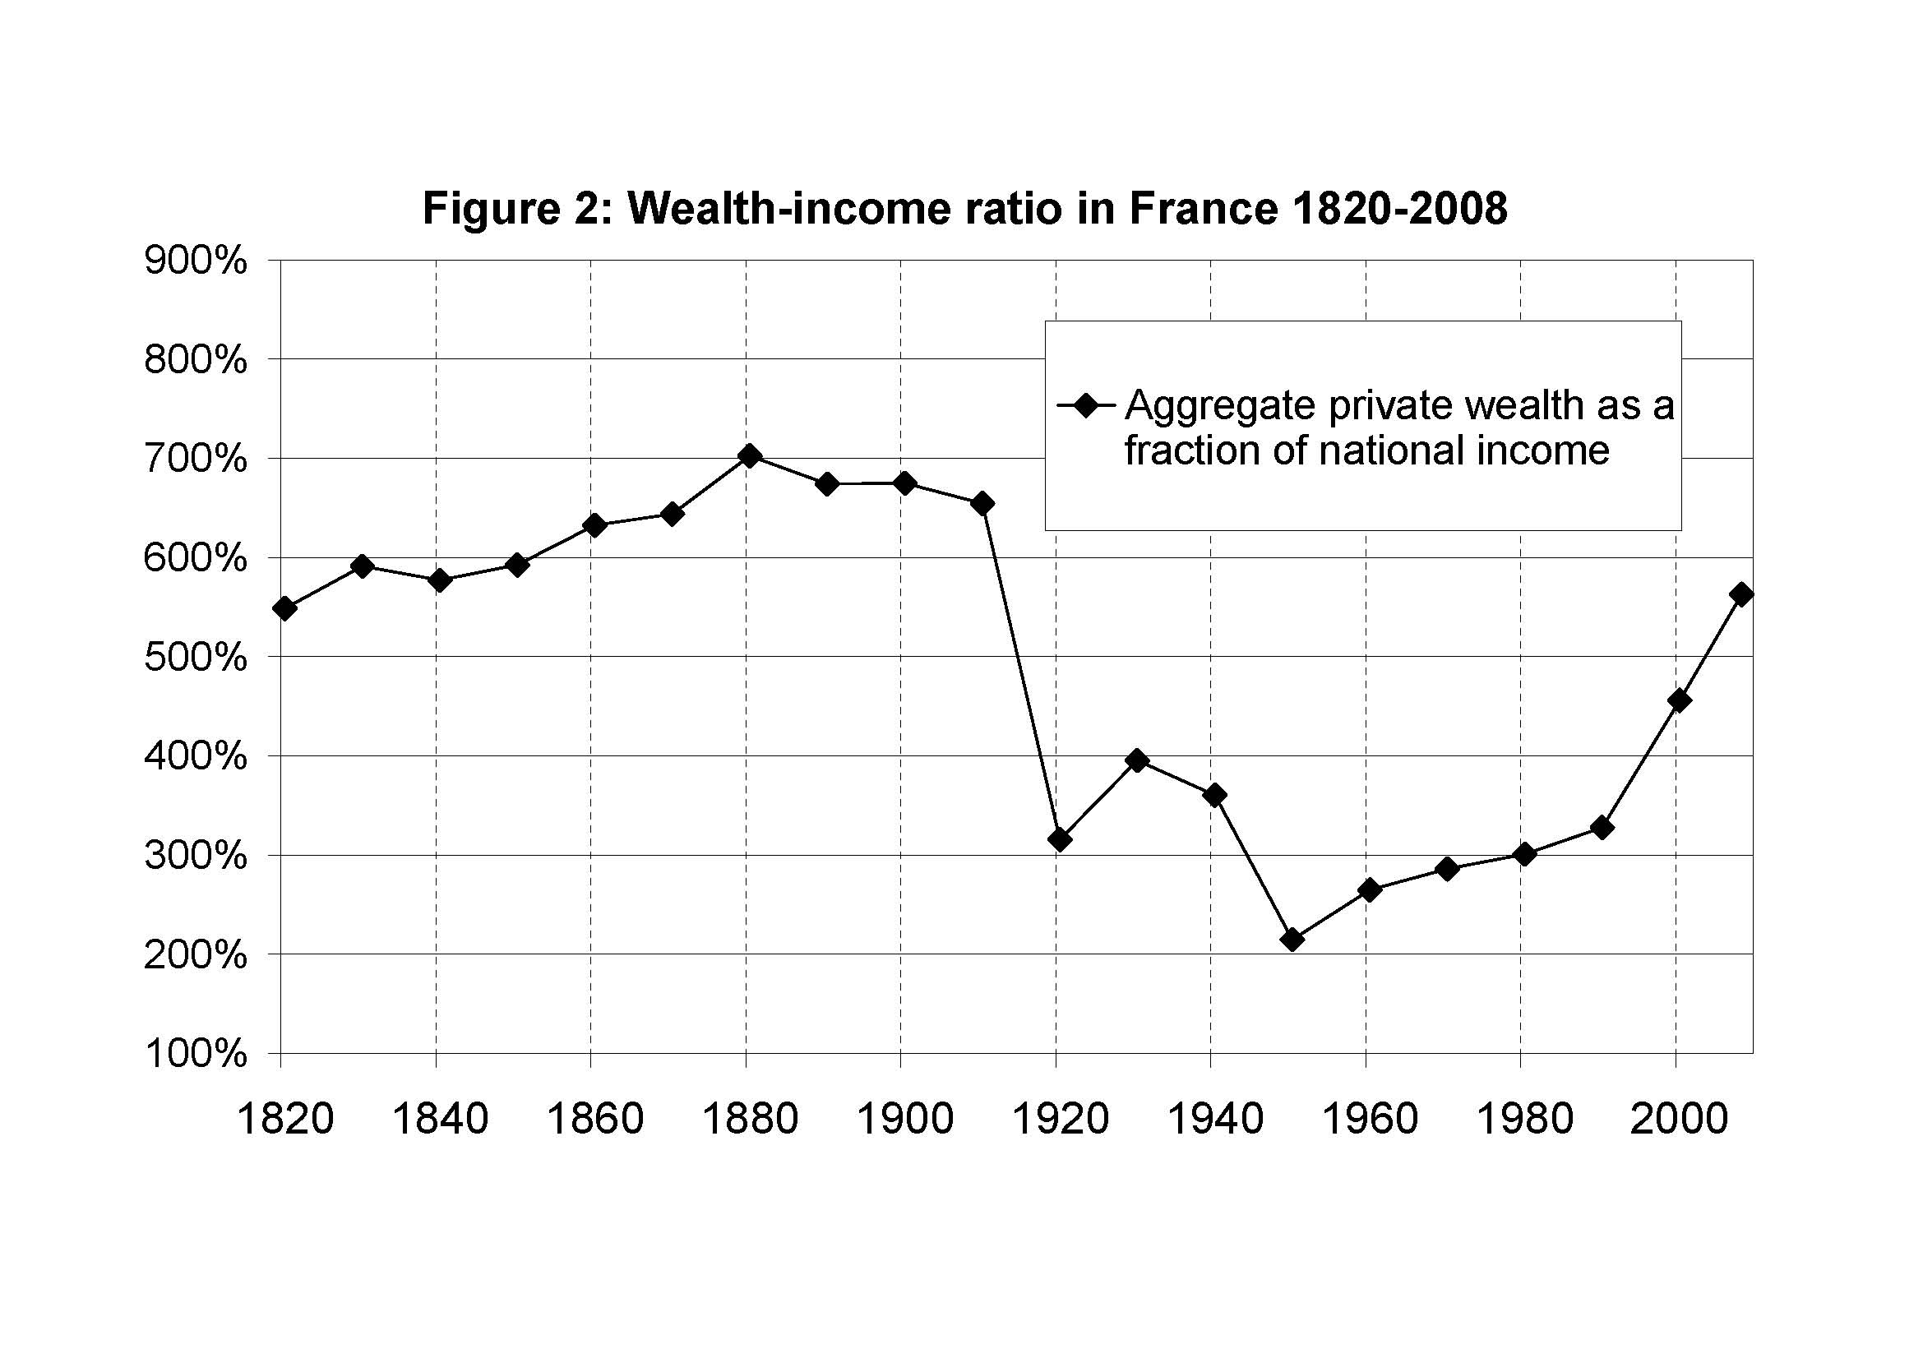

Slide 24
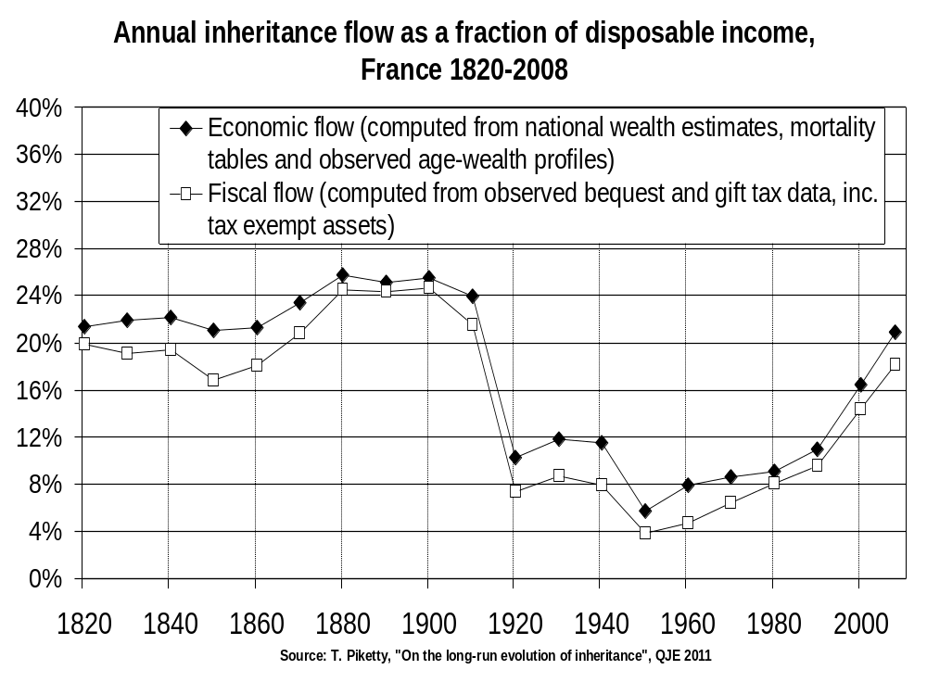

Slide 25
Conclusion
A world with g low & r>g is gloomy for workers with zero inherited wealth… especially if global tax competition drives capital taxes to 0%…especially if top labor incomes take a rising income share
Europe is particularly vulnerable: g very low (negative population growth in Italy, Spain, Germany), tax competition very high
In the long run, we need EU coordination on all capital taxes: inheritance taxes, wealth taxes
In the short run, let’s try at least not to suppress wealth taxes when the left is in power (Spain…)

